Slide 1
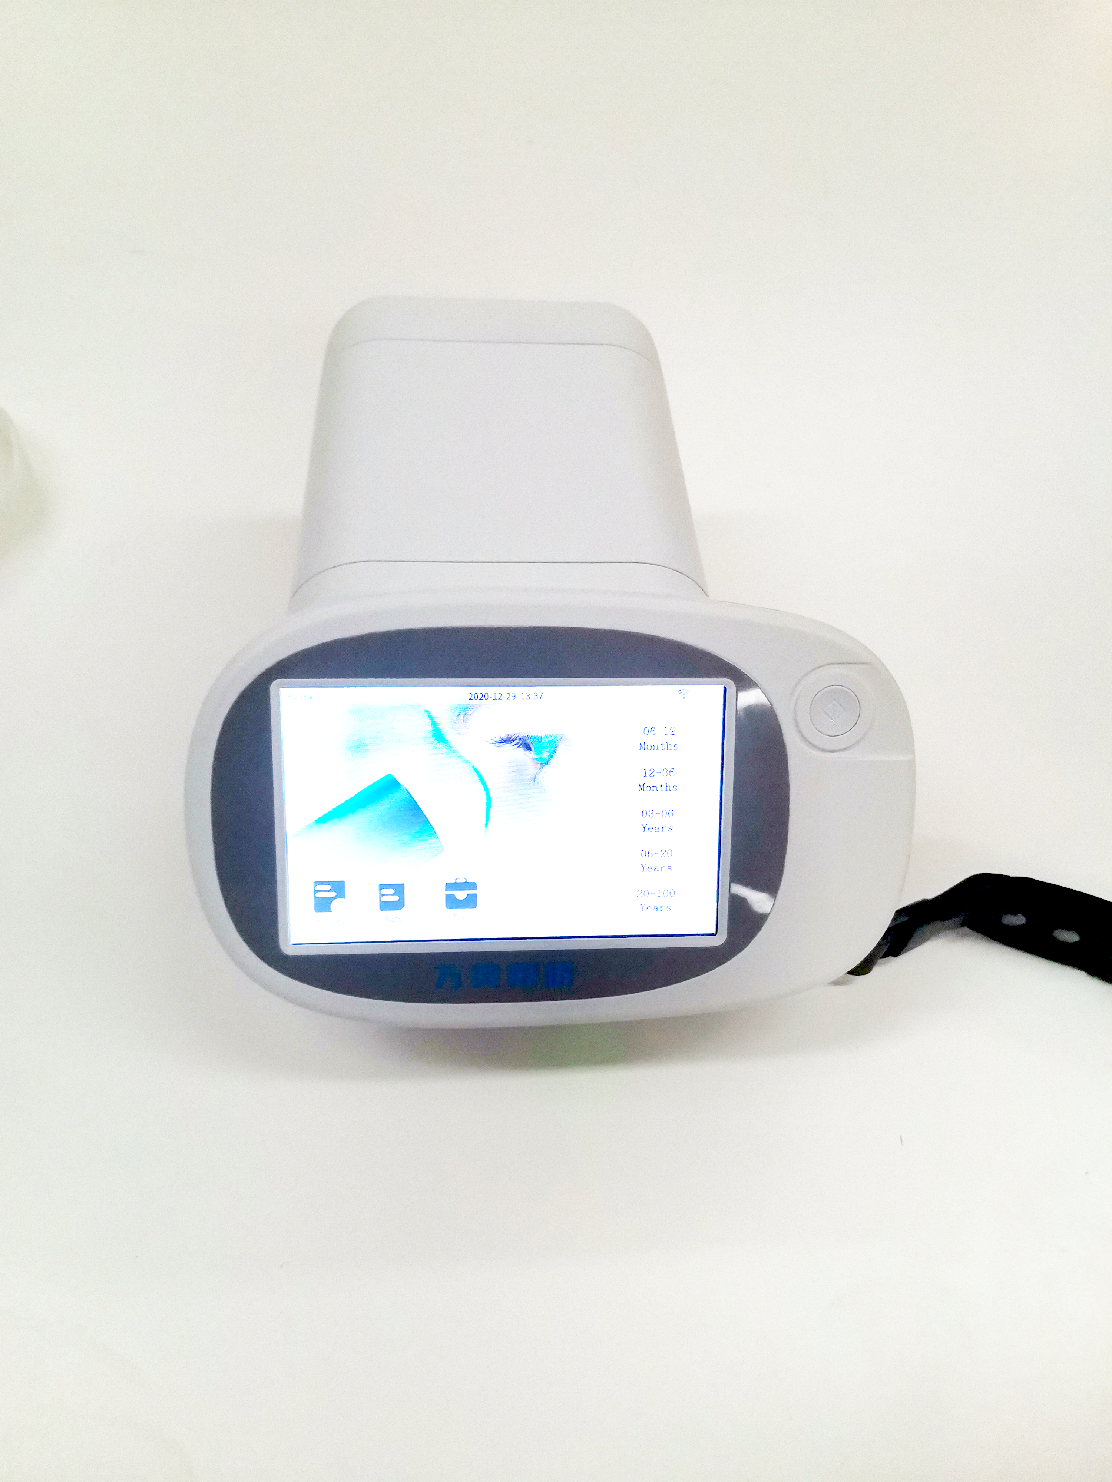
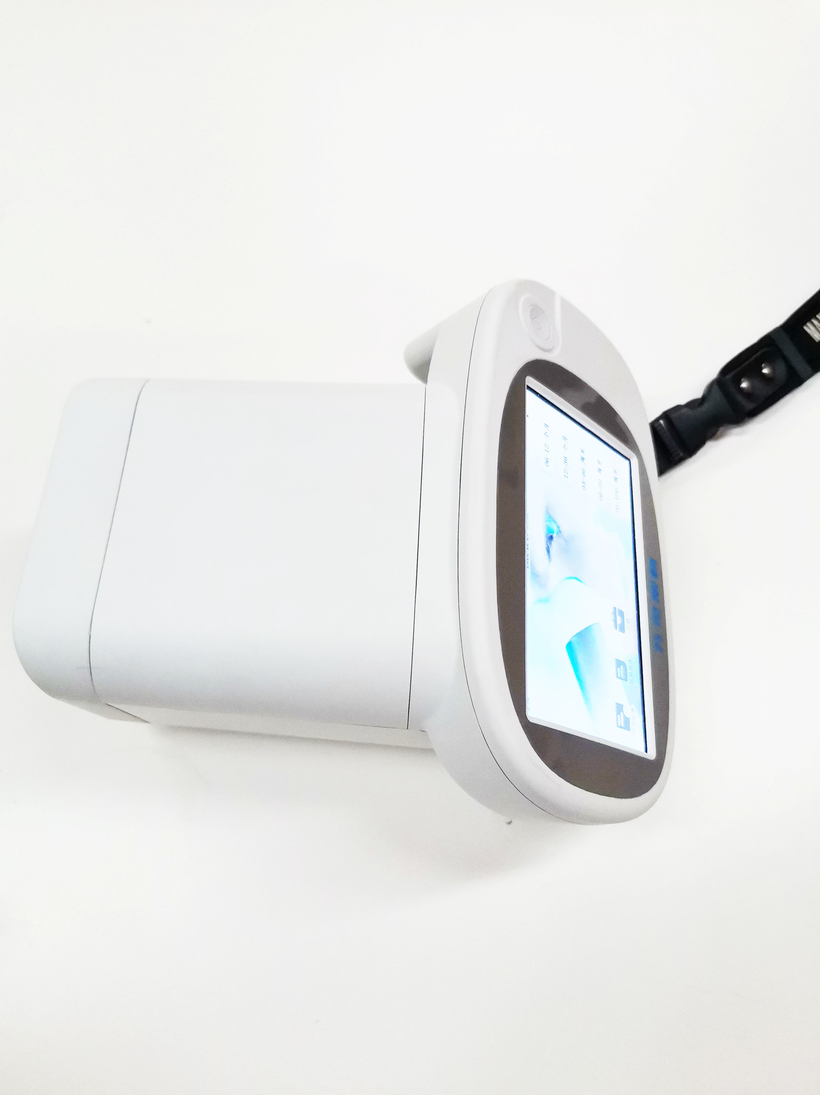
Vision Screener
VS-100
High speed testing for 2-4s, calculating time less than 1s
100cm±5cm measurement distance
Non-dilation and no limitation for measurement environment
Open for other ophthalmic equipment data transfer
Model No. | VS-100
Operation mode | Binocular
Detection mode | Auto
Spherical | -10.5D~+7.5D
Cylindrical | -3D~+3D
Axis | 1°～180°
Working distance | 100cm±5cm
Detection time | ＜1s
Fixation target | Red light
Data transfer | USB, Wifi, BT
Printer connection | USB, Wifi
Battery | Rechargeable battery, last for 5h
Size | 21*19*12cm
Screeen size | 5 inch
G.W. | 1.36kg
Options | Camera frame, printer,etc.
Suzhou Maxter Meditech Co., Ltd
Web:www.maxtermed.com

